Slide 1
Data Structures
Dr BJ Hubert Shanthan
Dr. V.Vaidhehi

Slide 2
A data structure is a technique of organizing the data so that the data can be utilized efficiently.
Mathematical/ Logical/ Abstract models/ Views: The data structure is the way of organizing the data that requires some protocols or rules. These rules need to be modeled that come under the logical/abstract model.
Implementation: The second part is the implementation part. The rules must be implemented using some programming language.
Advantages
These are the essential ingredients used for creating fast and powerful algorithms.
They help us to manage and organize the data.
Data structures make the code cleaner and easier to understand.

Slide 3
Abstract Data Type
An abstract data type is an abstraction of a data structure that provides only the interface to which the data structure must adhere.
The interface does not give any specific details about something should be implemented or in what programming language.
No Implementation Details
In C We will use Data Structures 🡪 Structures
A List is an abstract data type that is implemented using a dynamic array and linked list. A queue is implemented using linked list-based queue, array-based queue, and stack-based queue. A Map is implemented using Tree map, hash map, or hash table.
Abstraction: It is a technique of hiding the internal details from the user and only showing the necessary details to the user.
Encapsulation: It is a technique of combining the data and the member function in a single unit is known as encapsulation.

Slide 4
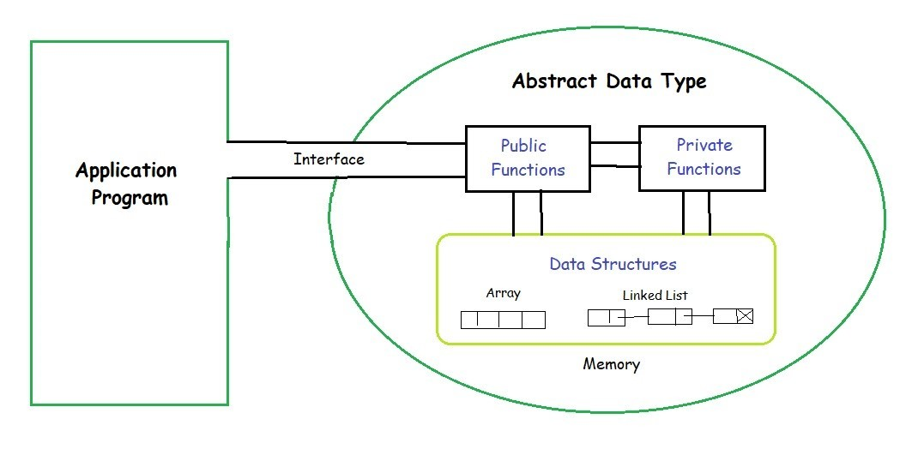
Structure Pointer 🡪 ADT

Slide 5
Structures in pointers
The structure pointer points to the address of a memory block where the Structure is being stored. Like a pointer that tells the address of another variable of any data type (int, char, float) in memory.
And here, we use a structure pointer which tells the address of a structure in memory by pointing pointer variable ptr to the structure variable.
The declaration of a structure pointer is similar to the declaration of the structure variable. So, we can declare the structure pointer and variable inside and outside of the main() function. To declare a pointer variable in C, we use the asterisk (*) symbol before the variable's name.
struct structure_name *ptr;
Initialization of the Structure Pointer
ptr = &structure_variable;
We can also initialize a Structure Pointer directly during the declaration of a pointer.
struct structure_name *ptr = &structure_variable;
As we can see, a pointer ptr is pointing to the address structure_variable of the Structure.
There are two ways to access the member of the structure using Structure pointer:
Using ( * ) asterisk or indirection operator and dot ( . ) operator.
Using arrow ( -> ) operator or membership operator.

Slide 6
ADT Advantages
Provides abstraction, which simplifies the complexity of the data structure and allows users to focus on the functionality.
Enhances program modularity by allowing the data structure implementation to be separate from the rest of the program.
Enables code reusability as the same data structure can be used in multiple programs with the same interface.
Promotes the concept of data hiding by encapsulating data and operations into a single unit, which enhances security and control over the data.
Supports polymorphism, which allows the same interface to be used with different underlying data structures, providing flexibility and adaptability to changing requirements.

Slide 7
Limitations of Arrays
An array which is formed will be homogeneous. That is, in an integer array only integer values can be stored, while in a float array only floating value and character array can have only characters. Thus, no array can have values of two data types.
While declaring an array, passing size of an array is compulsory, and the size must be a constant. Thus, there is either shortage or wastage of memory.
Shifting is required for insertion or deletion of elements in an array.
An array doesn’t check boundaries: In C language, we cannot check, if the values entered in an array are exceeding the size of that array or not.
Data that is entered with the subscript, exceeds the array size and will be placed outside the array. Generally, on the top of the data or the program itself.
This will lead to unpredictable results, to say the least. Also, there will be no error message to warn the programmer of going beyond the array size. In some cases, the program may hang.

Slide 8
Data Structures
Definition:
Organization of data
Logical or mathematical way of organizing data
Objectives
Real world data should match
Structure should be simple

Slide 9
Data Structures
Classification of Data Structures
Primitive
Int, float,char
Non-primitive
Linear
Arrays, linkedlist,stack,queue
Nonlinear
Trees ,graphs

Slide 10
Applications of Data Structures
Searching
sorting
graph traversing
finding the shortest path from one city to another, resolving traffic problems
processing online requests or online transactions,
alerting users of stock market prices
scheduling of jobs in operating systems
searching details of a student in a university data base ----etc
ARRAY
Linked List
Record
Tree
Graph

Slide 11
Operations of Data Structures
Traversal
Search
Insertion
Deletion
Sort
Merge

Slide 12
Operations of Array (1D & 2 D) Data Structures
1D ARRAY
Traversal
Search
Insertion
Beginning
End
Inbetween
Sorted array / unsorted array
Single value and multiple values
Array with unique elements/ repeated elements
Deletion
Beginning
End
Inbetween
Sorted array / unsorted array
Single value and multiple values
Array with unique elements/ repeated elements
Sort
Merge (insertion of multiple elements)
Beginning
End
inbetween
2 D ARRAY
Traversal
Search
Insertion (1 Row / 1 column)
Beginning
End
Inbetween
Deletion (1 Row / 1 column)
Beginning
End
Inbetween
Sort
Merge

Slide 13

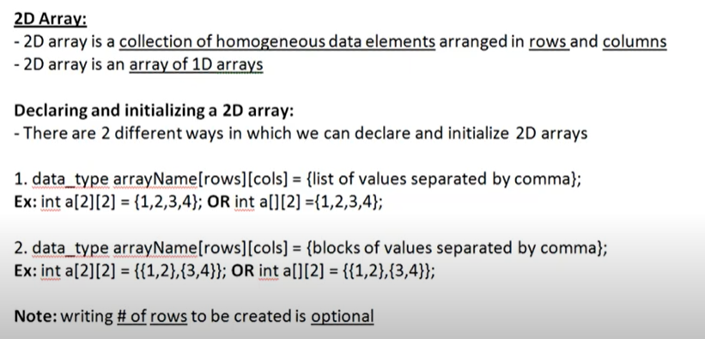
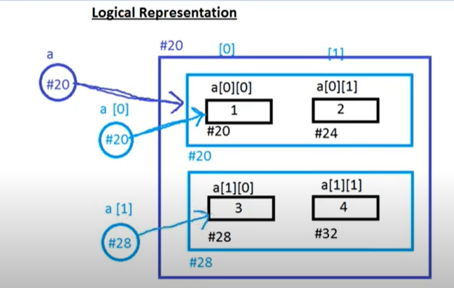
2 D Arrays

Slide 14
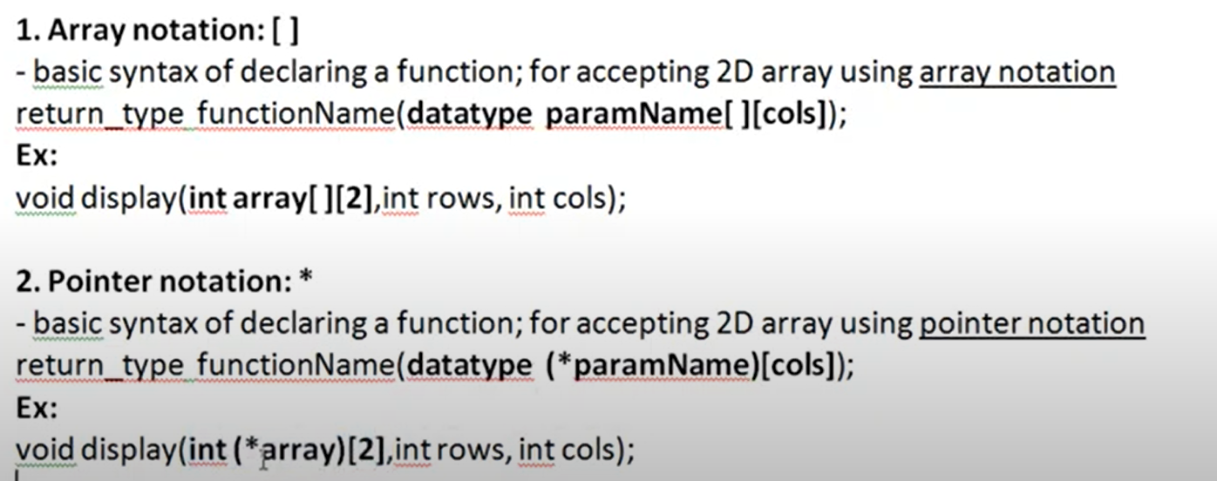
Passing 2d array as arguement

Slide 15
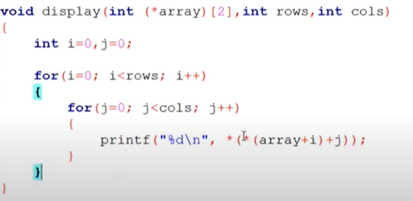
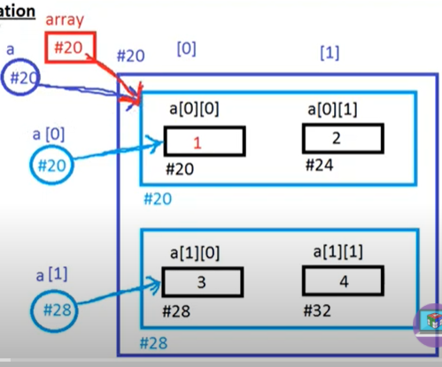
*(*array+0)+0
*(*20+0*length of the block)+0
*(*20+0*8)+0
*(*20)+0*length of the block
*(*20)+0*4
*(20+0)----1
*(*array+0)+1
*(*20+0*length of the block)+1
*(*20+0*8)+1
*(*20)+1*length of the block
*(*20)+1*4
*(24)----2
*(*array+1)+0
*(*20+1*length of the block)+0
*(*20+1*8)+0
*(*28)+0*length of the block
*(*28)+0*4
*(28+0)----3
*(*array+1)+1
*(*20+1*length of the block)+1
*(*20+1*8)+1
*(*28)+1*length of the block
*(*28)+1*4
*(32)----4

Slide 16
Dynamically Allocated Arrays:
Dynamic Memory Allocation
A procedure in which the size of a data structure (like Array) is changed during the runtime.
C provides 4 library functions to achieve dynamic memory allocation, under <stdlib.h>:
malloc()
calloc()
free()
realloc()

Slide 17
malloc():
“malloc” or “memory allocation” method in C is used to dynamically allocate a single large block of memory with the specified size.
It returns a pointer of type void which can be cast into a pointer of any form.

Slide 18
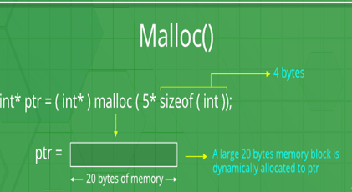
Syntax:
ptr = (cast-type*) malloc(byte-size)
Eg:
ptr = (int*) malloc(100 * sizeof(int));
//allocates 400 bytes of memory. And, the pointer ptr holds the address of the first byte in the allocated memory

Slide 19
calloc():
“calloc” or “contiguous allocation” method in C is used to dynamically allocate the specified number of blocks of memory of the specified type. It initializes each block with a default value ‘0’.
Syntax:
ptr = (cast-type*)calloc(n, element-size);
For Example:
ptr = (float*) calloc(25, sizeof(float));
//allocates memory for 25 elements each with the size of the float.

Slide 20
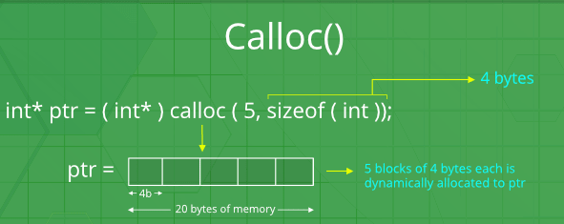
calloc” or “contiguous allocation” method in C is used to dynamically allocate the specified number of blocks of memory of the specified type.
It initializes each block with a default value ‘0’.
It has two parameters or arguments as compare to malloc().

Slide 21
free() :
“free” method in C is used to dynamically de-allocate the memory.
The memory allocated using functions malloc() and calloc() is not de-allocated on their own. Hence the free() method is used, whenever the dynamic memory allocation takes place. It helps to reduce wastage of memory by freeing it.
Syntax:
free(ptr);

Slide 22
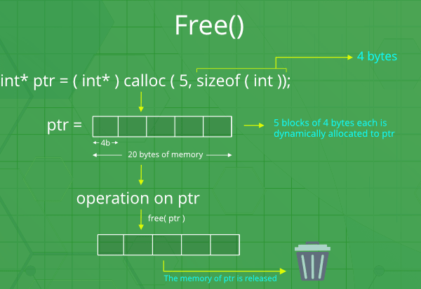

Slide 23
realloc() :
“realloc” or “re-allocation” method in C is used to dynamically change the memory allocation of a previously allocated memory.
If the memory previously allocated with malloc or calloc is insufficient, realloc is used to dynamically re-allocate memory.
re-allocation of memory maintains the already present value and new blocks will be initialized with default garbage value.
Syntax:
ptr = realloc(ptr, newSize);

Slide 24
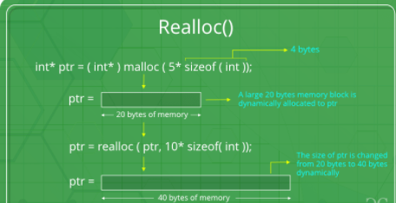


Slide 25
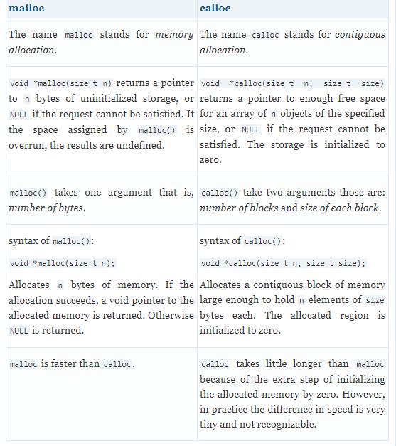


Slide 26
Structures:
A structure is a user-defined data type available in C that allows to combining data items of different kinds.
Structures are used to represent a record.
Syntax:
struct [structure name]
{
member definition;
member definition;
...
member definition;
};

Slide 27
Unions:
A union is a special data type available in C that allows storing different data types in the same memory location.
we can define a union with many members, but only one member can contain a valid data at any given time.
Unions provide an efficient way of using the same memory location for multiple purposes.

Slide 28
Syntax:
union [union name]
{
member definition;
member definition;
...
member definition;
};

Slide 29
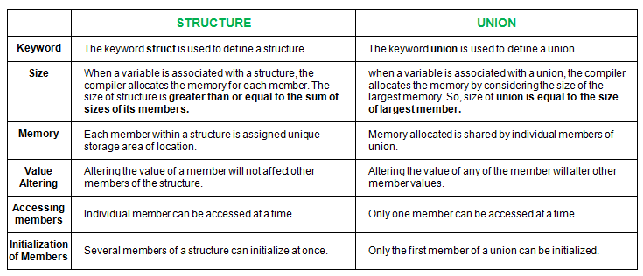
Similarities:
Both are user-defined data types used to store data of different types as a single unit.
Difference:

Slide 30
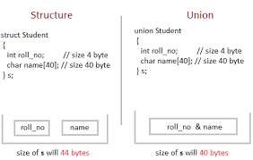

Slide 31
A structure variable can either be declared with structure declaration or as a separate declaration like basic types.
// A variable declaration with structure declaration.
struct Point
{
int x, y;
} p1; // The variable p1 is declared with 'Point'

Slide 32
// A variable declaration like basic data types
struct Point
{
int x, y;
};
int main()
{
struct Point p1; // p1 is declared like a normal variable
}

Slide 33
How to initialize structure members?
Structure members cannot be initialized with declaration.
Eg: the following C program fails in compilation.
struct Point
{
int x = 0; // COMPILER ERROR: cannot initialize members here
int y = 0; // COMPILER ERROR: cannot initialize members here
};
Why this error?

Slide 34
when a data type is declared, no memory is allocated for it. Memory is allocated only when variables are created.
Structure members can be initialized using curly braces ‘{}’.
Eg:
int main()
{ // member x gets value 0 and y gets value 1. The order of declaration is followed.
struct Point p1 = {0, 1};
printf ("x = %d, y = %d", p1.x, p1.y); //accessing struct variables
}

Slide 35
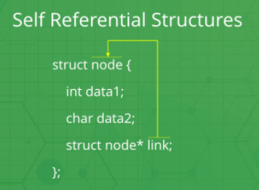
Self-Referential Structures:
Self Referential structures are those structures that have one or more pointers in it, which point to the same type of structure, as their member.
- ‘link’ is a pointer to a structure of type ‘node’.

Slide 36
Analysis of algorithm
Space complexity
The space complexity of a program is the amount of memory it needs to run to completion
Time complexity
The time complexity of a program is the amount of computer time that it needs to run to completion

Slide 37
Space Complexity
Fixed space requirement
Instruction space
Simple variables
Fixed size structure variables
Constants
Variable space requirement
Structured variables whose size depends on instance
Recursion
Number , size, values of the inputs and outputs
Total space requirement of any program S(P)= c+Sp(l)

Slide 38
BIG Oh Notation
1 | constant
log n | logarithmic
n | linear
n log n | n-log-n
n² | quadratic
n³ | cubic
2^{n} | exponential
n! | factorial
upper bound estimator
used for worst case analysis
BEST CASE
WORST CASE
AVERAGE CASE
SORT
SEARCH
O (1) < O (n) < O (n log n) < O (n²) < O(n³) < O(2^{n})

Slide 39
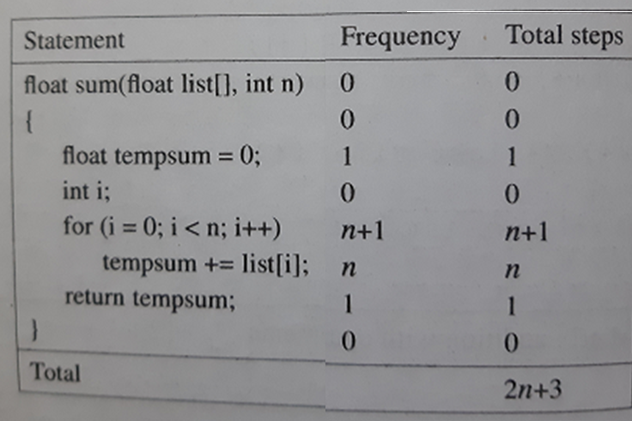

Slide 40
Time Complexity; O(1)
for (int i = 1; i<= c; i++)
{
// some O(1) expressions
}
A loop or recursion that runs a constant number of times is also considered as O(1). For example the following loop is O(1).

Slide 41
Time Complexity: O(n)
for (int i = 1; i<= n; i += c)
{
// some O(1) expressions
}
for (int i = n; i> 0; i -= c)
{
// some O(1) expressions
}
Time Complexity of a loop is considered as O(n) if the loop variables is incremented / decremented by a constant amount

Slide 42
Time Complexity: O(n²)
for (int i = 1; i<=n; i += c)
{
for (int j = 1; j <=n; j += c)
{
// some O(1) expressions
}
}
Time complexity of nested loops is equal to the number of times the innermost statement is executed. O(n²)

Slide 43
Time Complexity: O(Log n)
for (int i = 1; i<=n; i *= c)
{
// some O(1) expressions
}
for (int i = n; i> 0; i /= c)
{
// some O(1) expressions
}
Time Complexity of a loop is considered as O(Log n) if the loop variables is divided / multiplied by a constant amount

Slide 44
Linear Search/ Search Algorithm (sequential search)
LA - linear array with N elts; Algorithm to find an element with a value of ITEM, and return its position
1. Start
2. Set J = 0
3. Repeat steps 4 and 5 while J < N
4. IF LA[J] is equal ITEM THEN GOTO STEP 6
5. Set J = J +1
6. PRINT J, ITEM
7. Stop

Slide 45
The original array elements are : (searching for 5)
LA[0] = 1
LA[1] = 3
LA[2] = 5
LA[3] = 7
LA[4] = 8
Found element 5 at position 3

Slide 46
How many comparisons will happen in the following code (next slide) , for worst case, for an array of N elements?
Number of element comparisons----------n
Number of index comparisons-----n+1
Total comparisons-----2N+1

Slide 47
//linear search function
int linearSearch(int array[],int target, int size){
int position=0;
while(array[position]!=target){
if(position==size)
return -1;
else position++;}
return position; }
// code snippet of main()
int p=linearSearch(arr,t,s);
if (p==-1)
printf("%d is not in the array",t);
else printf("%d is found at %d position",t,p);

Slide 48
Recursion:
The process in which a function calls itself
Corresponding function is called as recursive function.
Using recursive algorithm, certain problems can be solved quite easily.
Eg: addition of first n natural numbers
approach 1 approach 2
– Simply adding one by one – Recursive adding
f(n) = 1 + 2 + 3 +……..+ n f(n) = 1 n=1
f(n) = n + f(n-1) n>1

Slide 49
PROBLEM SOLVING
Problems that can be solved
Recursive functions,
Iterative functions
A recursive function always performs tasks by dividing it into subtasks.

Slide 50
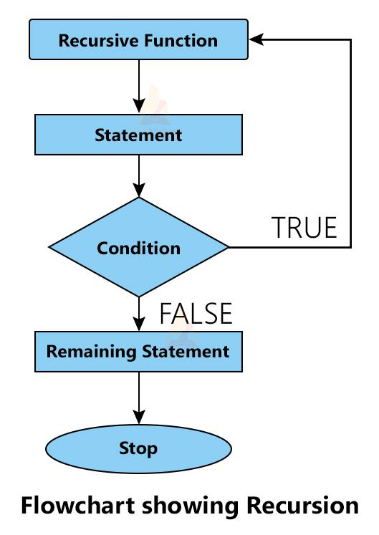
BASE CONDITION
While using recursion, you will have to define an exit condition on that function, if not then it will go into an infinite loop.

Slide 51
Types of recursion in C
int fib(int num)
{
if (num==1 || num==2)
return 1;
else
return (fib(num-1)+fib(num-2));
}
There are two types of recursion present in the C programming language.
Direct Recursion
If a function calls itself directly then the function is known as direct recursive function.
Indirect Recursion
A function that does not call itself directly then function is known as an indirect recursive function.
int first_function(int num)
{
if (num<=2)
return 2;
else
return new_function(num);
}
int new_function(int num)
{
return first_function(num);
}

Slide 52
Applications of USING RECURSIVE METHODS
Sorting
Searching
traversal problems
Factorial
Fibonacci series
Towers of Hanoi

Slide 53
Memory allocation of recursive method:-
In C, each recursive function call creates a copy of it in memory. When some data is returned from the recursive call then the memory releases the copy.
all variables, arguments and other things of function get stored in the stack.

Slide 54
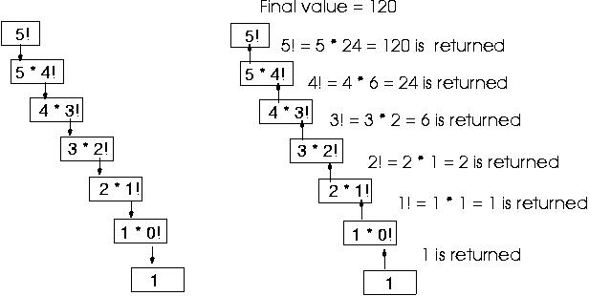
factorial function
int Factorial(int n)
{
if (n==0) // base case
return 1;
else
return n * Factorial(n-1);
}

Slide 55
Advantages of Recursion in C
Makes the program elegant.
It adds clarity to the program code and also reduces the time to write the code.
Reduces time complexity.

Slide 56
Disadvantages of Recursion in C
It is slower than non recursive programs due to the overhead of maintaining the stack.
It requires more memory for the stack.

Slide 57
Bubble sort
simplest sorting algorithm
repeatedly iterate through the array and swap adjacent elements that are unordered.
repeat this until the array is sorted.
Why bubble sort is called “bubble” sort?
because the elements with greater value than the adjacent element “bubble” towards the end.

Slide 58
Example---1
5 | 4 | 3 | 2 | 1
4 | 5 | 3 | 2 | 1
4 | 3 | 5 | 2 | 1
4 | 3 | 2 | 5 | 1
4 | 3 | 2 | 1 | 5
4 | 3 | 2 | 1
3 | 4 | 2 | 1
3 | 2 | 4 | 1
3 | 2 | 1 | 4
3 | 2 | 1
2 | 3 | 1
2 | 1 | 3
2 | 1
1 | 2

Slide 59
Psuedo code
void bubbleSort(int arr[], int n)
{
int i, j;
for (i = 0; i < n-1; i++)
// Last i elements are already in place
for (j = 0; j < n-i-1; j++)
if (arr[j] > arr[j+1])
swap(arr[j], arr[j+1]);
}

Slide 60
Example---1-----iteration----1
0 | 1 | 2 | 3 | 4 | I | J
5 | 4 | 3 | 2 | 1 | 0 | 0
4 | 5 | 3 | 2 | 1 | 0 | 1
4 | 3 | 5 | 2 | 1 | 0 | 2
4 | 3 | 2 | 5 | 1 | 0 | 3
4 | 3 | 2 | 1 | 5
N=5
i<n-1
j<n-1-I
i==0
J varies between 0 to 3
(arr[j] > arr[j+1])

Slide 61
Example---1-----iteration----2
0 | 1 | 2 | 3 | 4 | I | J
5 | 4 | 3 | 2 | 1 | 0 | 0
4 | 5 | 3 | 2 | 1 | 0 | 1
4 | 3 | 5 | 2 | 1 | 0 | 2
4 | 3 | 2 | 5 | 1 | 0 | 3
4 | 3 | 2 | 1 | 5
4 | 3 | 2 | 1 | 5 | 1 | 0
3 | 4 | 2 | 1 | 5 | 1 | 1
3 | 2 | 4 | 1 | 5 | 1 | 2
3 | 2 | 1 | 4 | 5
N=5
i<n-1
j<n-1-I
i==1
J varies between 0 to 2
(arr[j] > arr[j+1])

Slide 62
Example---1-----iteration----3
0 | 1 | 2 | 3 | 4 | I | J
5 | 4 | 3 | 2 | 1 | 0 | 0
4 | 5 | 3 | 2 | 1 | 0 | 1
4 | 3 | 5 | 2 | 1 | 0 | 2
4 | 3 | 2 | 5 | 1 | 0 | 3
4 | 3 | 2 | 1 | 5
4 | 3 | 2 | 1 | 5 | 1 | 0
3 | 4 | 2 | 1 | 5 | 1 | 1
3 | 2 | 4 | 1 | 5 | 1 | 2
3 | 2 | 1 | 4 | 5
3 | 2 | 1 | 4 | 5 | 2 | 0
2 | 3 | 1 | 4 | 5 | 2 | 1
2 | 1 | 3 | 4 | 5
N=5
i<n-1
j<n-1-I
i==2
J varies between 0 to 1
(arr[j] > arr[j+1])

Slide 63
Example---1-----iteration----4
0 | 1 | 2 | 3 | 4 | I | J
5 | 4 | 3 | 2 | 1 | 0 | 0
4 | 5 | 3 | 2 | 1 | 0 | 1
4 | 3 | 5 | 2 | 1 | 0 | 2
4 | 3 | 2 | 5 | 1 | 0 | 3
4 | 3 | 2 | 1 | 5
4 | 3 | 2 | 1 | 5 | 1 | 0
3 | 4 | 2 | 1 | 5 | 1 | 1
3 | 2 | 4 | 1 | 5 | 1 | 2
3 | 2 | 1 | 4 | 5
3 | 2 | 1 | 4 | 5 | 2 | 0
2 | 3 | 1 | 4 | 5 | 2 | 1
2 | 1 | 3 | 4 | 5
2 | 1 | 3 | 4 | 5 | 3 | 0
1 | 2 | 3 | 4 | 5 | 3
N=5
i<n-1
j<n-1-I
i==3
J varies between 0 to 1
(arr[j] > arr[j+1])

Slide 64
Characteristics of Bubble Sort:
Large values are always sorted first.
It only takes one iteration to detect that a collection is already sorted.
The best time complexity for Bubble Sort is O(n). The average and worst time complexity is O(n²).
The space complexity for Bubble Sort is O(1), because only single additional memory space is required.

Slide 65
Applications of Array Data Structure:
Storing and accessing data:
Sorting:
Searching:
Matrices:
Stacks and queues:
Graphs (cost adjacency matrix)
Dynamic programming: Dynamic programming algorithms often use arrays to store intermediate results of subproblems in order to solve a larger problem.

Slide 66
Real-Time Applications of Array:
Signal Processing:
Multimedia Applications:
Data Mining: Arrays are used in data mining applications to represent large datasets. This allows for efficient data access and processing, which is important in real-time applications.
Robotics:
Real-time Monitoring and Control Systems:
Financial Analysis:
Scientific Computing:

Slide 67
Advantages of array data structure:
Efficient access to elements:
Fast data retrieval:
Memory efficiency:
Versatility:
Easy to implement:
Compatibility with hardware:

Slide 68
Disadvantages of array data structure:
Fixed size:
Memory allocation issues:
Insertion and deletion issues: Inserting or deleting an element from an array can be inefficient and time-consuming because all the elements after the insertion or deletion point must be shifted to accommodate the change.
Wasted space:
Limited data type support:
Lack of flexibility:

Slide 69
Types of Matrix:
Row matrix 1 x n
Column matrix n x 1
Null matrix (all elements are zero)
Square matrix
Diagonal matrix
Sparse matrix
Spiral matrix
Identity matrix
Triangular matrix
Symmetric matrix (A = A^{T}

Slide 70
Advantages of Matrix Data Structure:
It helps in 2D Visualization.
It stores multiple elements of the same type using the same name.
Elements can be accessed using an index.
It enables access to items at random.
Any form of data with a fixed size can be stored.
It is easy to implement.
It is the simplest 2D data structure.
It is used by all programming languages.

Slide 71
Disadvantages of Matrix Data Structure:
The matrix’s size must be known beforehand.
It is of fixed size and its size can’t be modified further.
Insertion and deletion operations are costly if shifting occurs.
Memory wastage may result if the specified matrix size is more than what is required.
Resizing a matrix can be time-consuming, especially if it needs to be done frequently or the size of the matrix is very large.
No built-in functionality.

